Slide 1


Tourism & Travel
BY GROUP 3
Preeti
Sanjolie
Meghana
Ritika
Harshika

Slide 2

Index
Case Study
Scenario
ER Diagram
Mapping 1 & its workflow and output
Mapping 2 & its workflow and output
Mapping 3 & its workflow and output
Mapping 4 & its workflow and output
Test Cases

Slide 3

1. Case study
'Tourism & Travel', a hospitality company that is head quartered in Mahabalipuram, has different branches in all parts of India.
‘Tourism & Travel’, now wants to understand the trends of eating & purchasing habits of guests. In addition to identifying people visiting the establishments are local or tourists, they also want to determine the peak hours of visitors visiting the branches.

Slide 4


2. scenarios
To understand the trends of eating habits of visitors.
To understand the trends of purchasing habits of visitors.
To identify people visiting the establishments are local or tourists.
To determine the peak hours of visitors visiting the branches.

Slide 5
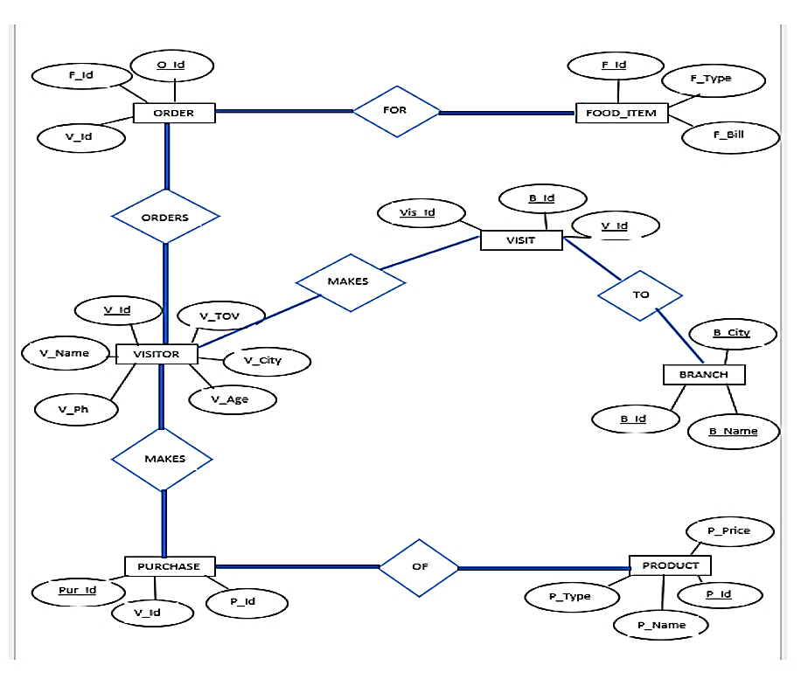
3. ER Diagram

Slide 6
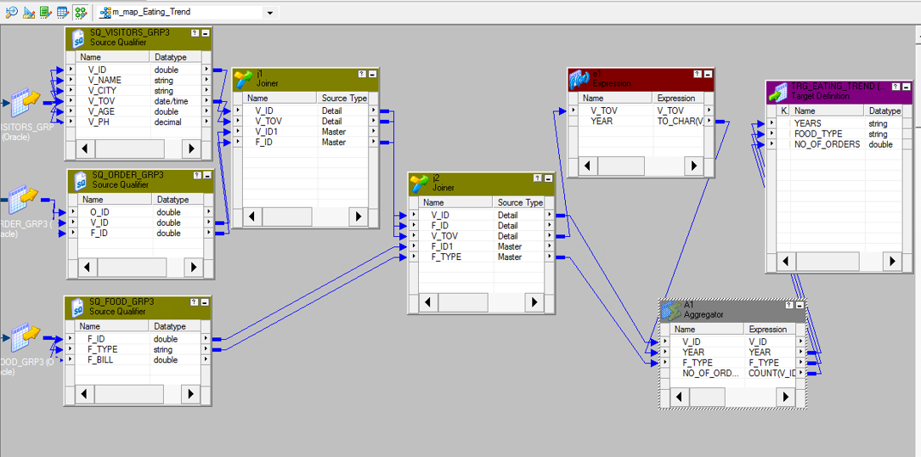
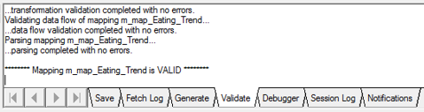
4.1 Mapping 1
Eating Trends

Slide 7
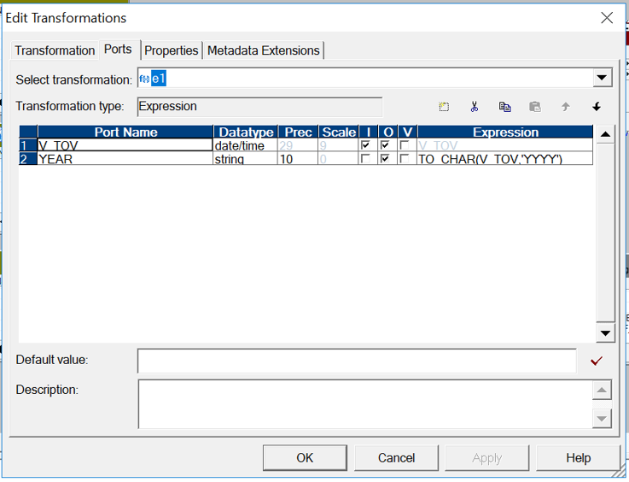
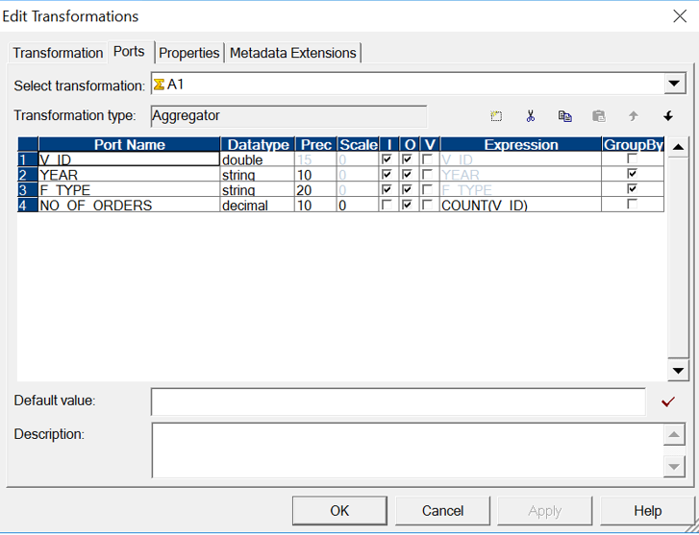
4.2 CONDITIONS

Slide 8
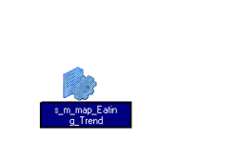
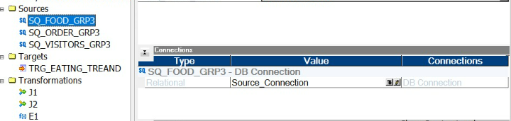
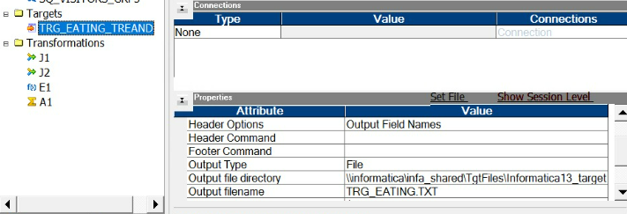
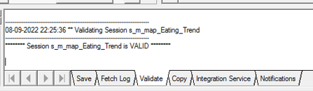
4.3 Session
Source Connection
Target Connection

Slide 9
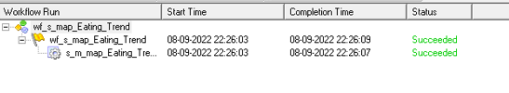
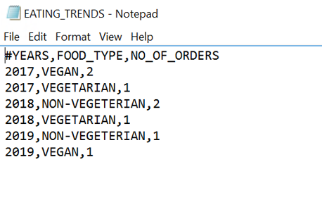
4.4 Output

Slide 10
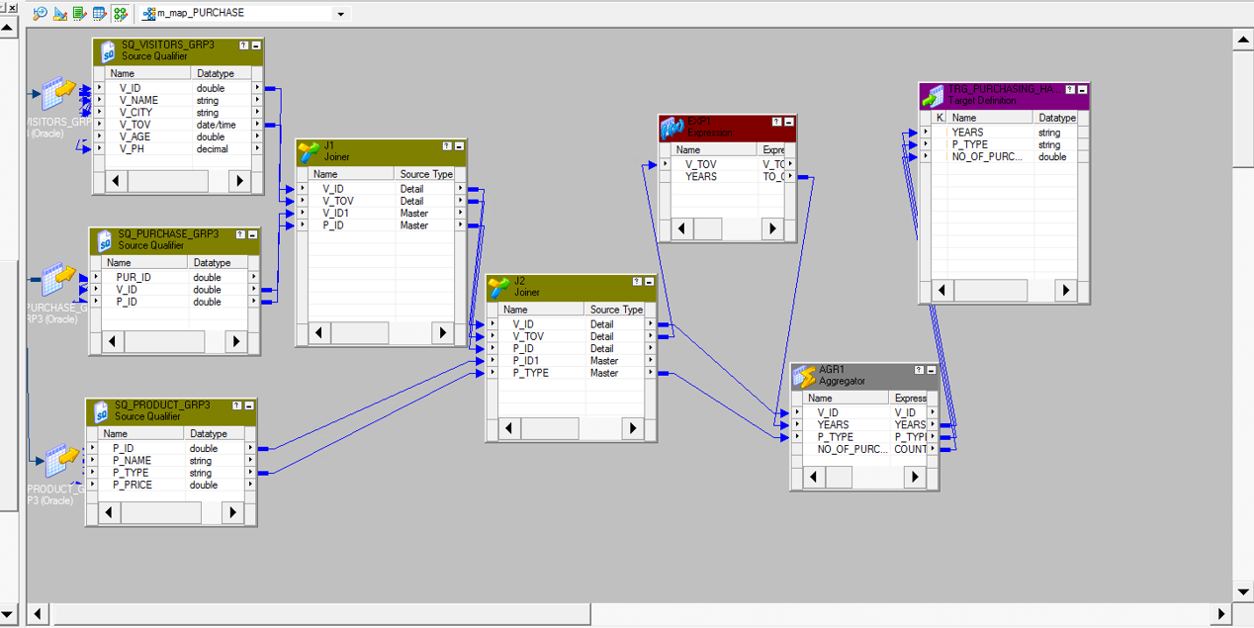
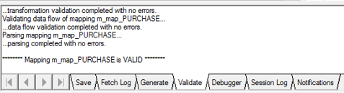
5.1 Mapping 2
Purchasing Habits

Slide 11
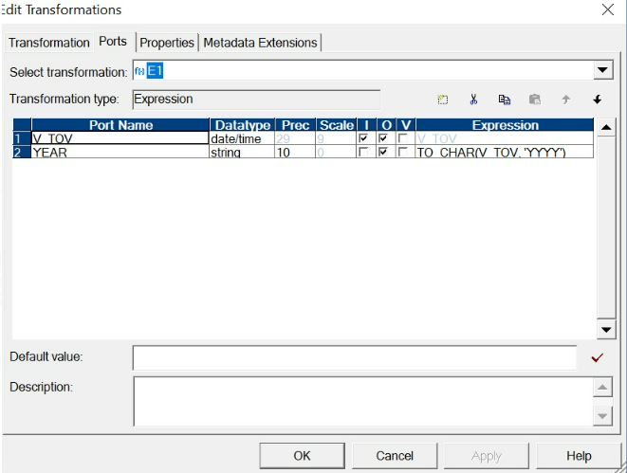
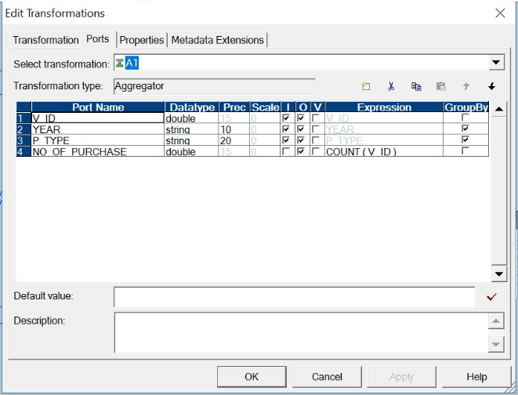
5.2 Conditions

Slide 12
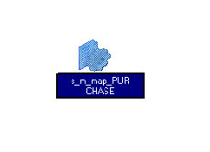
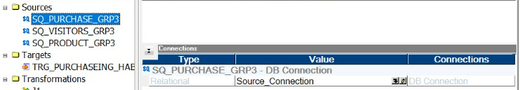
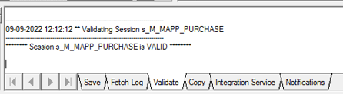
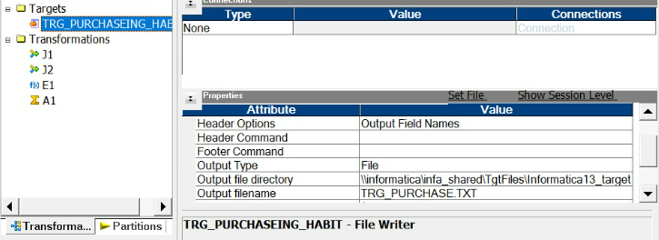
5.3 Session
Source Connection
Target connection

Slide 13
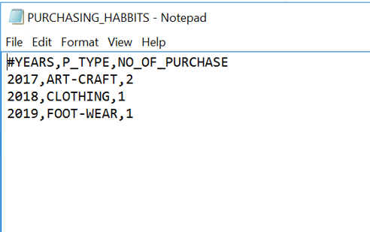
5.4 output

Slide 14
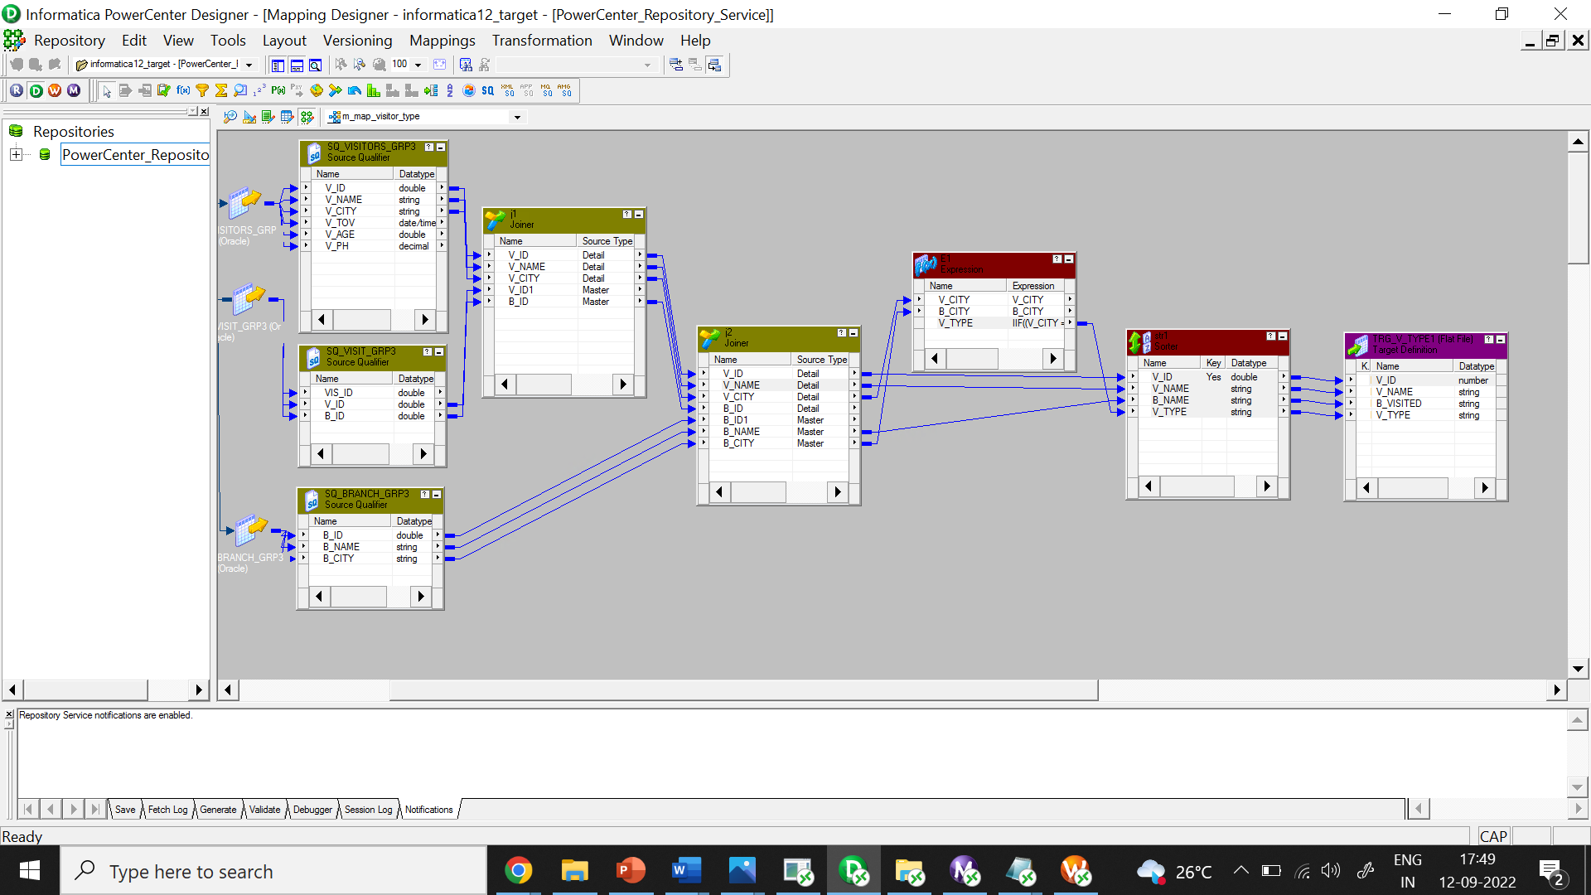
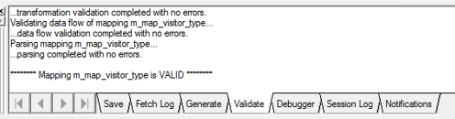
6.1 Mapping 3
Visitor Type

Slide 15
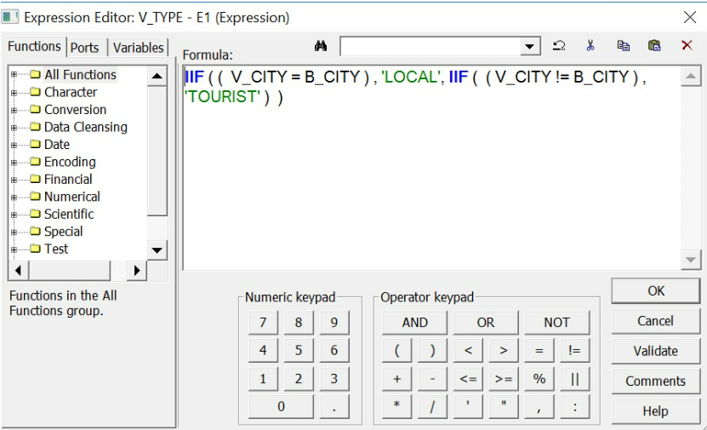
6.2 Conditions

Slide 16

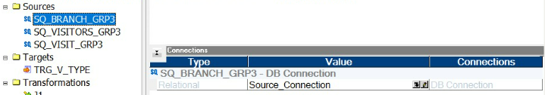
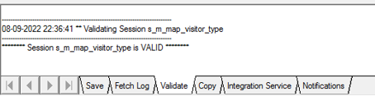
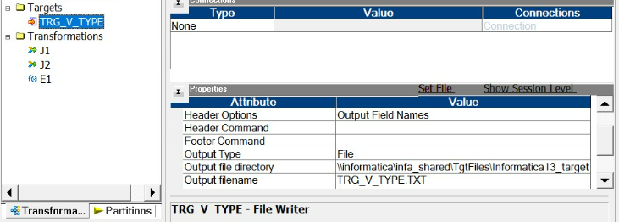
6.3 Session
Source Connection
Target Connection

Slide 17
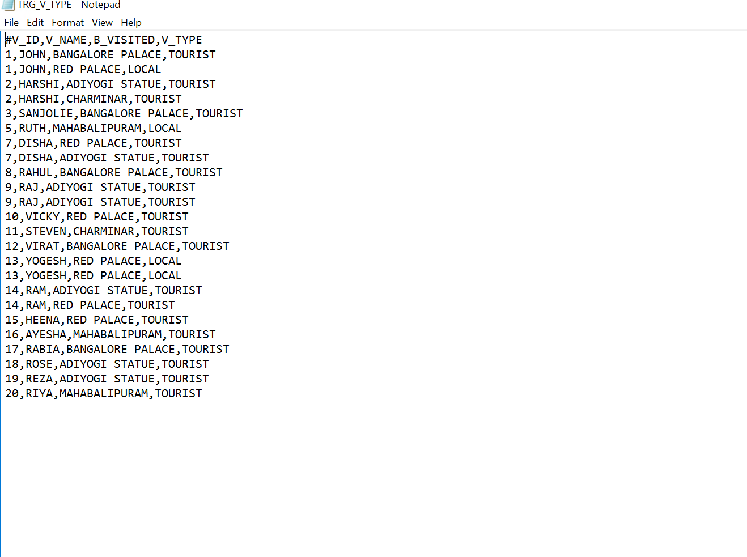
6.4 output

Slide 18
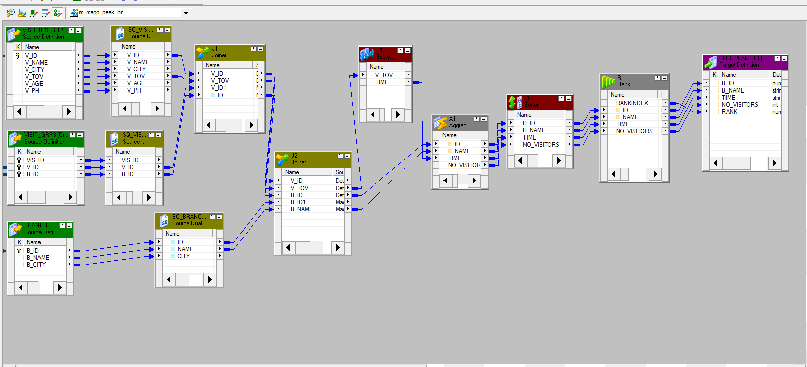
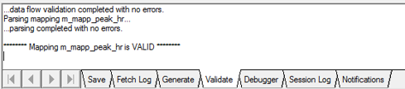
7.1 Mapping 4
Peak hours

Slide 19
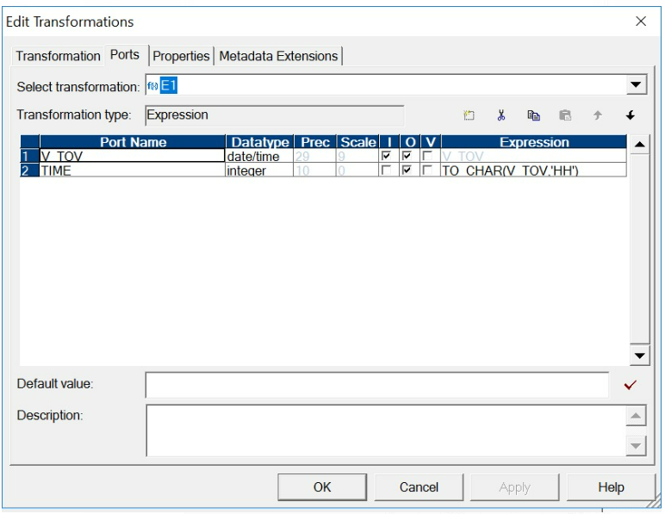
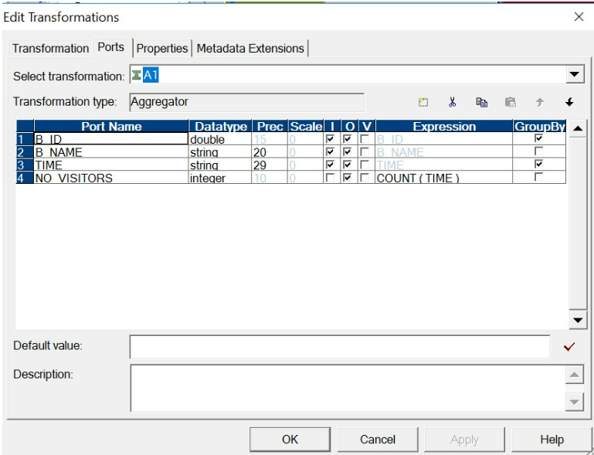
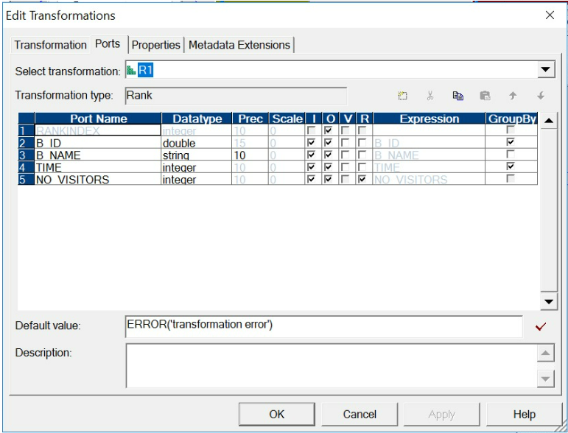
7.2 conditions

Slide 20
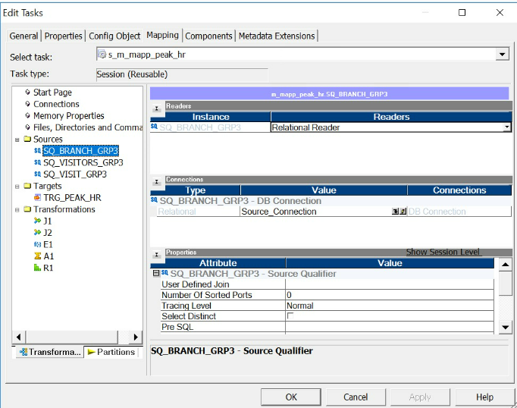
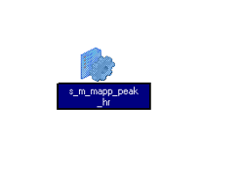
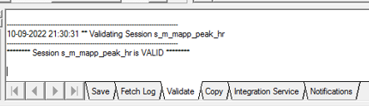
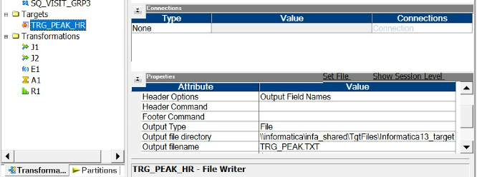
7.3 Session
Source Connection
Target connection

Slide 21
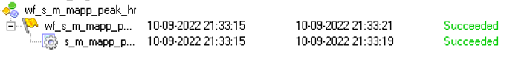
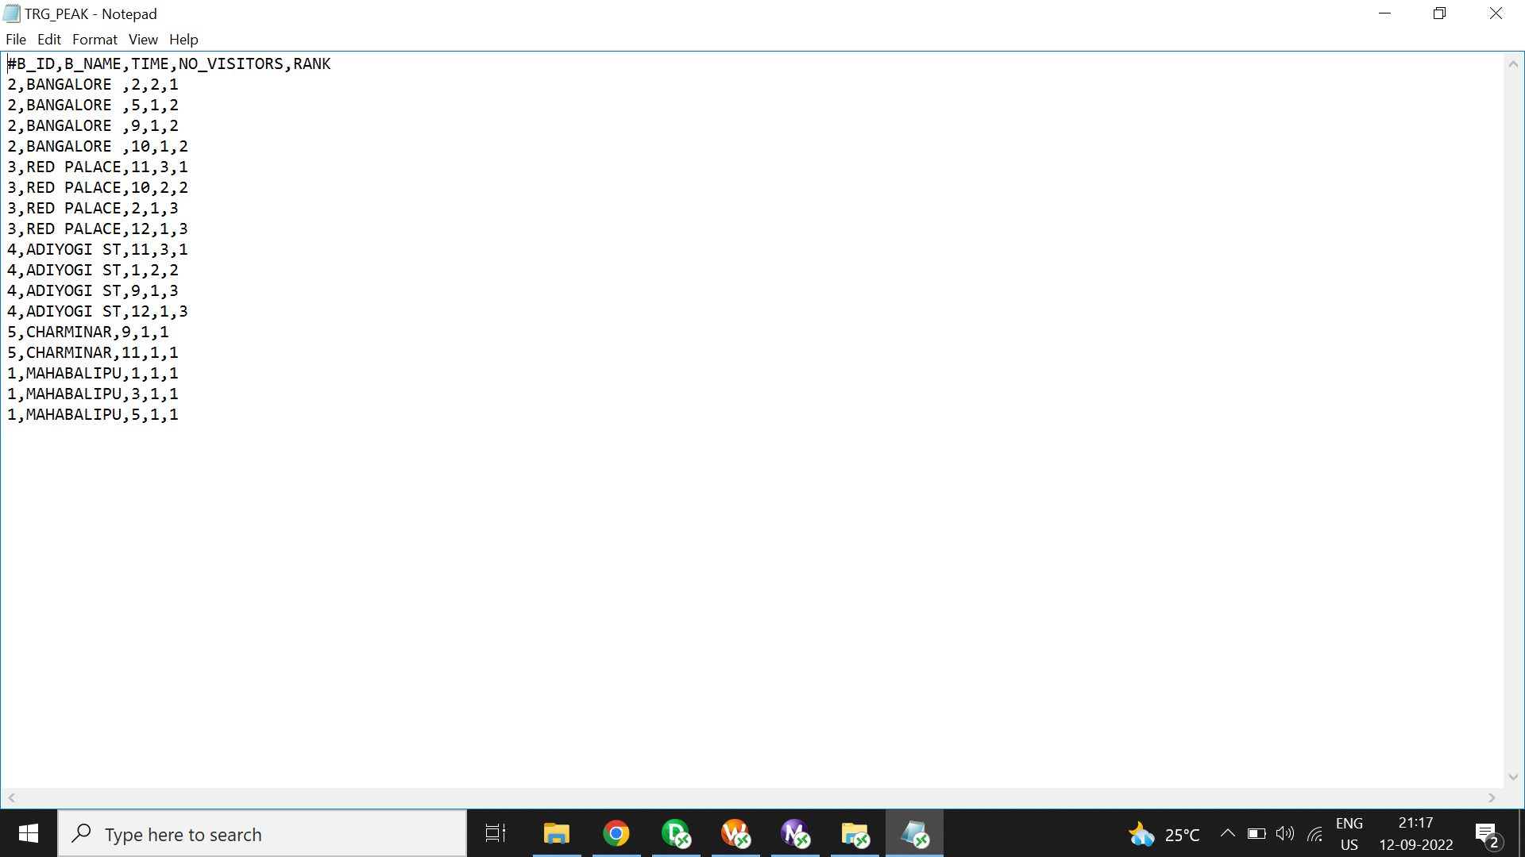
7. 4 Output

Slide 22
8.1 Unit Testing
Test Cases | Test case 1 | Test case 2 | Test case 3 | Test case 4
Source | VISITORS_GRP3, ORDER_GRP3, FOOD_GRP3 | VISITORS_GRP3, PURCHASE_GRP3, PRODUCT_GRP3 | VISITORS_GRP3, VISIT_GRP3, BRANCH_GRP3 | VISITORS_GRP3, VISIT_GRP3, BRANCH_GRP3
Target | TRG_EATING_TREND | TRG_PURCHASING_HABBIT | TRG_V_TYPE | TRG_PEAK_HR
Mapping | m_map_Eating_Trend | m_map_PURCHASE | m_map_visitor_type | m_map_Peak_hr
Transformation | Joiner Expression Aggregator | Joiner Expression Aggregator | Joiner Expression Sorter | Joiner Expression Aggregator Sorter Rank
Remarks | PASS | PASS | PASS | PASS

Slide 23
8.2 Integration testing
Test Cases | Test case 1 | Test case 2 | Test case 3 | Test case 4
Source | VISITORS_GRP3, ORDER_GRP3, FOOD_GRP3 | VISITORS_GRP3, PURCHASE_GRP3, PRODUCT_GRP3 | VISITORS_GRP3, VISIT_GRP3, BRANCH_GRP3 | VISITORS_GRP3, VISIT_GRP3, BRANCH_GRP3
Target | TRG_EATING_TREND | TRG_PURCHASING_HABBIT | TRG_V_TYPE | TRG_PEAK_HR
Session | s_ m_map_Eating_Trend | s_ m_map_PURCHASE | s_ m_map_visitor_type | s_ m_map_Peak_hr
Workflow | wf_s_m_mapp_Eating_trend | wf_s_m_mapp_PURCHASE | wf_s_m_mapp_VISITOR_TYPE | wf_s_m_mapp_PEAK_
Transformation | Joiner Expression Aggregator | Joiner Expression Aggregator | Joiner Expression Sorter | Joiner Expression Aggregator Rank Sorter
Remarks | PASS | PASS | PASS | PASS

Slide 24
8.3 Regression testing
Test Cases | Test case 1 | Test case 2 | Test case 3 | Test case 4
Source | VISITORS_GRP3, ORDER_GRP3, FOOD_GRP3 | VISITORS_GRP3, PURCHASE_GRP3, PRODUCT_GRP3 | VISITORS_GRP3, VISIT_GRP3, BRANCH_GRP3 | VISITORS_GRP3, VISIT_GRP3, BRANCH_GRP3
Target | TRG_EATING_TREND | TRG_PURCHASING_HABBIT | TRG_V_TYPE | TRG_PEAK_HR
Workflow | wf_s_m_mapp_Eating_trend | wf_s_m_mapp_PURCHASE | wf_s_m_mapp_VISITOR_TYPE | wf_s_m_mapp_PEAK_
Transformation | Joiner Expression Aggregator | Joiner Expression Aggregator | Joiner Expression Sorter | Joiner Expression Aggregator Sorter Rank
Remarks | PASS | PASS | PASS | PASS
Tester comment | The transformation of processed data to the target does not impact on the sources and functions as it was before executing the code

Slide 25


Thank you

